Slide 1
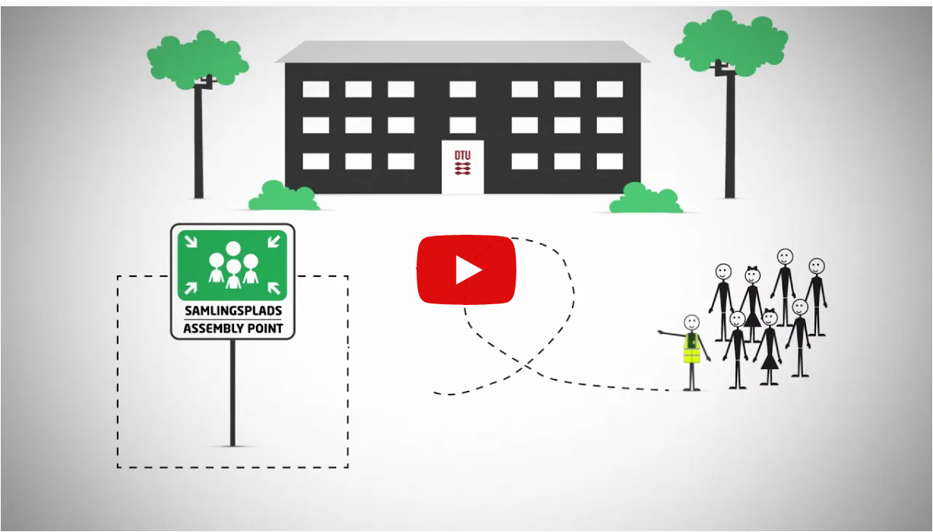
Safety Moment
Beredskab på DTU
DK: https://www.youtube.com/watch?v=39x0n9ruM-M&feature=youtu.be
DK undertekster: https://www.youtube.com/watch?v=ENivxxq51IY&feature=youtu.be
ENG: https://www.youtube.com/watch?v=csTSBi0Nm0c&feature=youtu.be
ENG undertekster: https://www.youtube.com/watch?v=y-VgjH33bpM&feature=youtu.be

