Slide 1
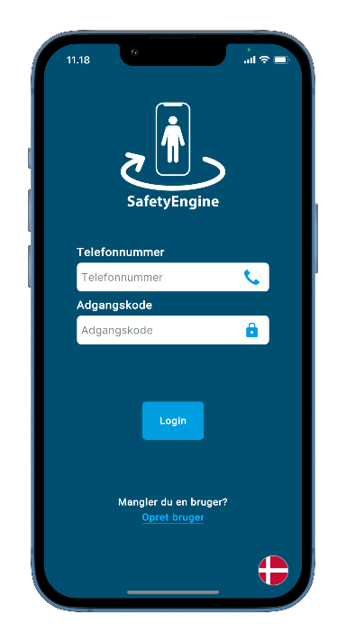


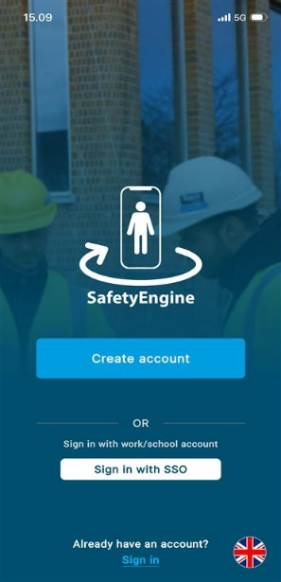

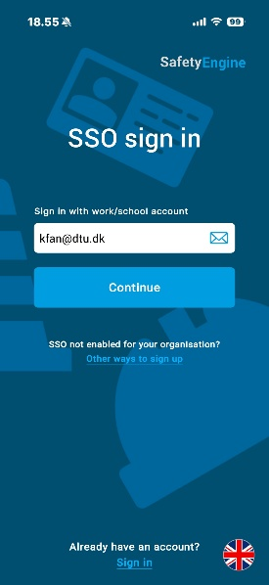
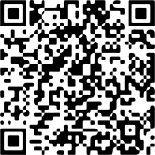
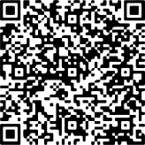

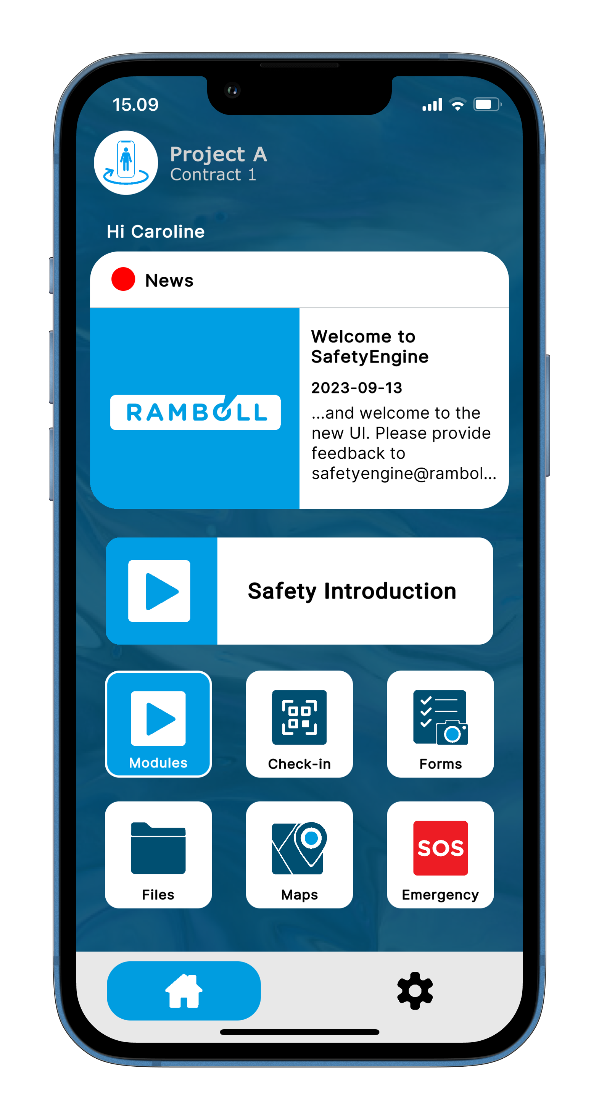
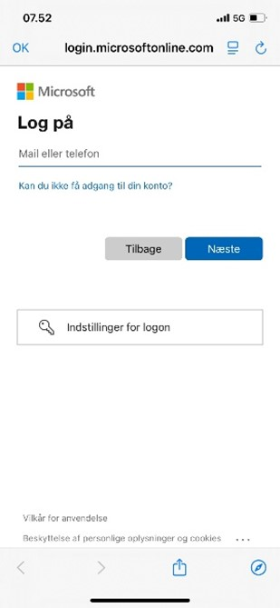
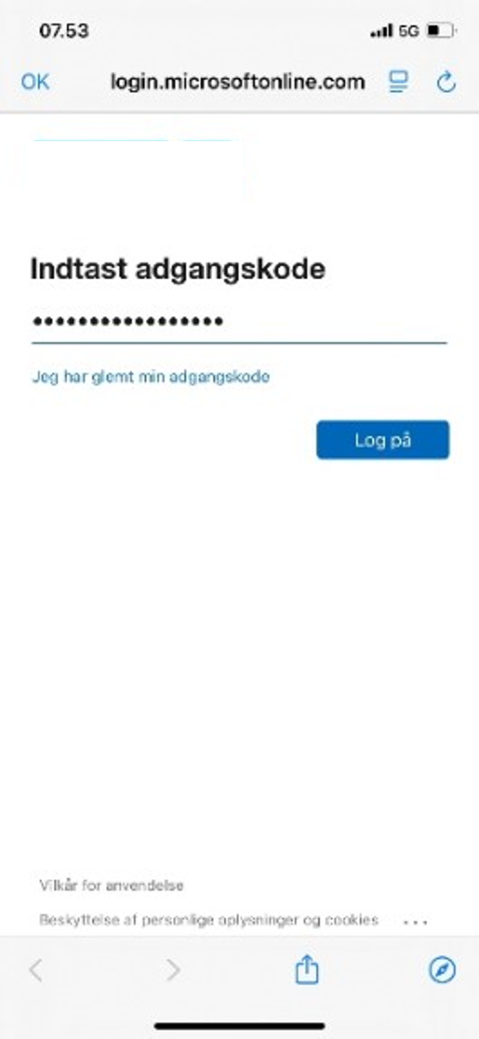
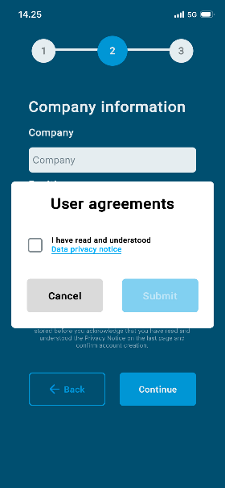
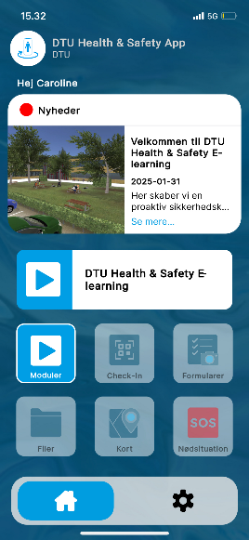
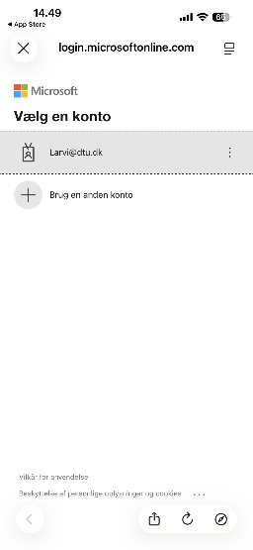
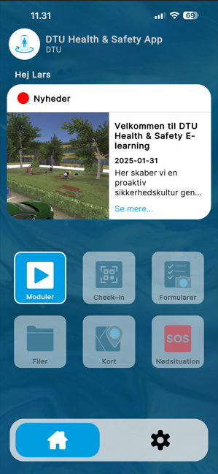



Welcome to DTU Health & Safety E-learning
Internal
1
2
STEP 1 Download SafetyEngine where you normally get apps
App Store
Google Play
STEP 2 Log in with SSO by entering your DTU email
3
4
5+6
STEP 3 Use your DTU email and password to log in
STEP 4 Accept user agreements
STEP 5 Change language under settings
STEP 6 Complete the DTU Health & Safety E-learning - Click on and
DTU Health & Safety E–learning

