Slide 1
Safe sleep in rough seas
Safety Moment

Slide 2
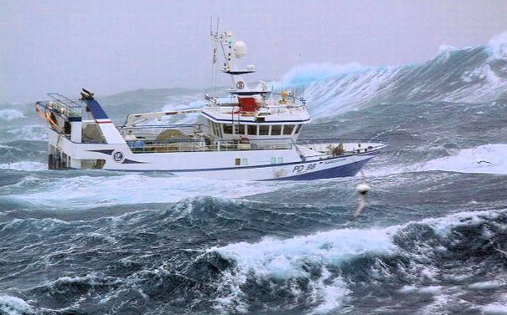
Safe sleep in rough seas
If possible stay home if the weather is bad
Avoid falling out of the bed/bunk bed by:
using the bunk rail (guard rail) if any
moving the mattress down to the floor
using pillows, bags, spare clothing packed along the bunk

