Slide 1
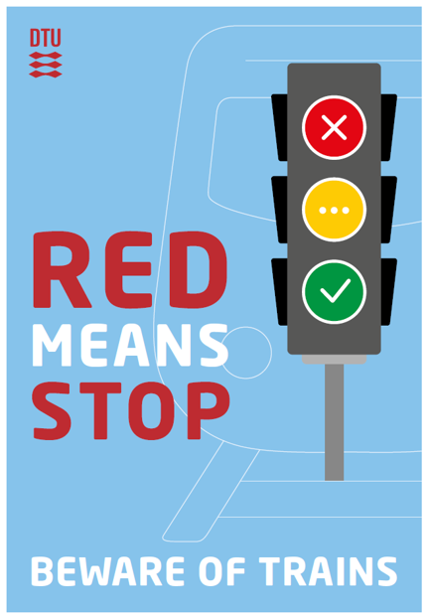
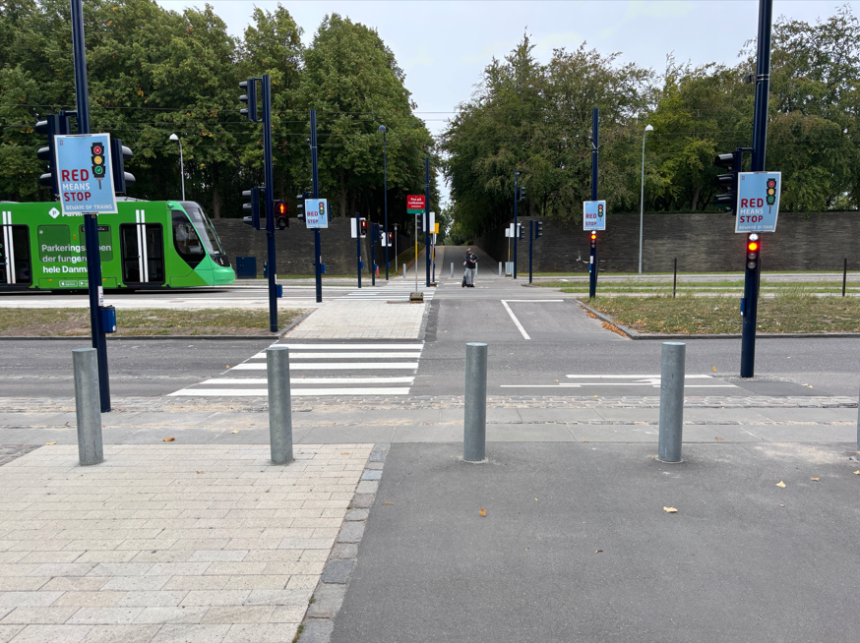
Safety Moment - Light rail at DTU
A change in behavior is needed to strengthen safety around the light rail
Initiatives launched regarding behavior change
Ongoing information about traffic behavior on Inside
DTU –sigs established at crossings
Agreement with the organizers (AUS) for the intro days
  KABS and vectors, special focus on good traffic behavior
Campaign: The good cycling culture
Issues discussed at director meeting in September
Safety Moment at AMK Network Meeting
  Call for AMK to address the topic in own unit
Respect traffic legislation
Respect signs and traffic lights
Look up from your cell phone
Take the music out of your ears
Light rail drivers are concerned about the traffic behavior they experience at DTU
Everyone must take responsibility for good traffic behavior

