Slide 2
Improve the conversation
Safety moment

Slide 3
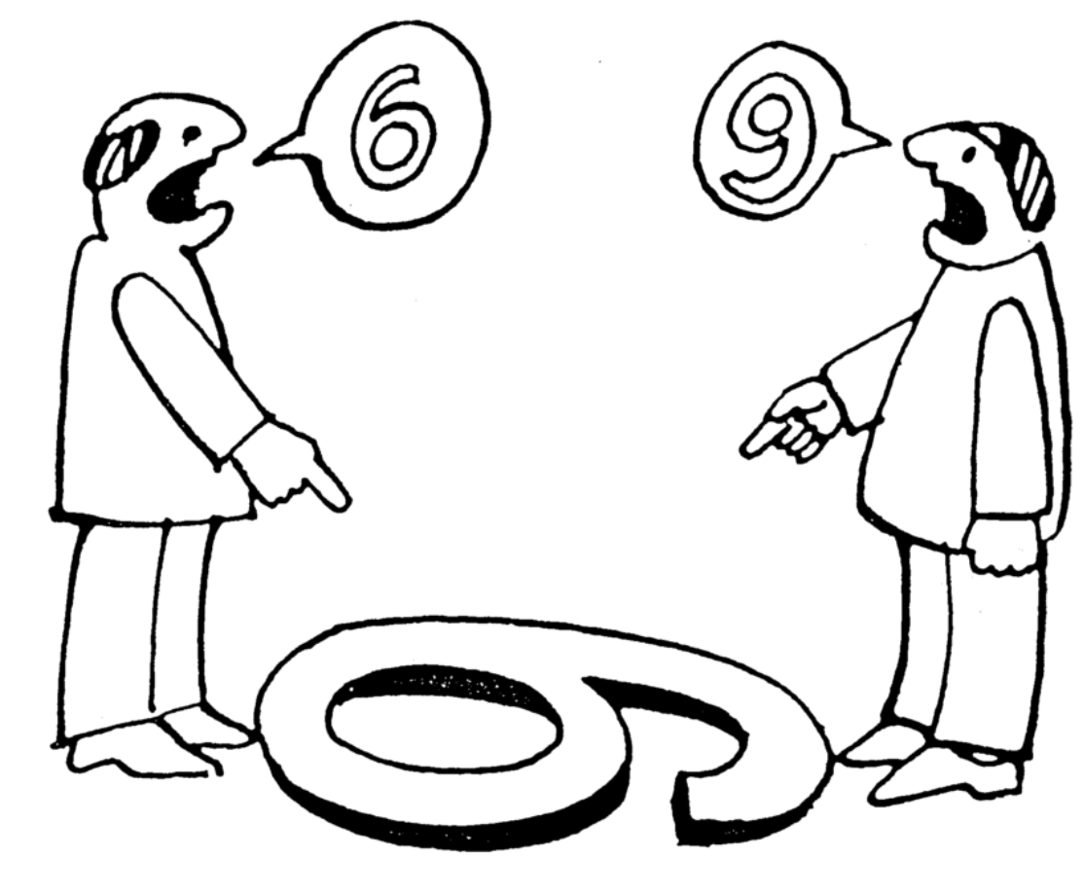
Styrk samtalen
The steps of the conversation
Dialogue
Discussion
Communication through action
Personficaton
The problem grows
6. The conversation is abandoned altogether
7. Hostility
What to do
Listen to the other party’s problem
remain calm and patient
assess whether your solution will cause new problems for the other
stay focused on the issue and not the attitude
set realistic options for the other
Notes:
I will tell you a little about the mechanisms of having to communicate ‘the difficult message’ to a collaboration partner. It’s a familiar role we often face.
All staff and students will experience situations where difficult messages need to be communicated. To customers, collaboration partners, or directly to colleagues and fellow students. It can be anything from having to approach someone who throws trash on the ground, performs dangerous work at height, or who opposes an agreement or project.
When meeting the person and delivering the message, it is a clear advantage to know about the different steps of the conversation (Samtalens Trin) to more easily recognize a possible escalation and thus decelerate the process and take it down a step.
The steps of the conversation consist of:
Dialogue—where the issue is solved by the parties involved, you believe in the good intentions of each other.
Discussion—the parties argue that their particular view is the right one, you talk, and you listen.
The other steps include focus on mistakes, past conflicts, limitations, moving from the issue to the person with reproaches and accusations. If this point is reached, actively go back past the red line.
Communication through action—dialogue is limited and the other party does as they see fit (demonstration)
Personification—focus shifts from the issue to the person, and other people/supporters are involved
The problem grows—focuses on mistakes, finds new mistakes, past conflicts, words as ‘always’ and ‘never’
The conversation is abandoned altogether—avoids and rejects each other and no longer talks to each other
Hostility—the opposing party blames, interprets, and accuses of wrongful things.
The ability to deliver the message depends on the receiver’s reaction, but also on the way the message is delivered—and therefore it starts with yourself.
Try to be clear about the actual nature of the message—is it a
suggestion
point of attention
correction
new direction or
claim (standard, procedure, law)
Now be aware that the message must start at step 1 and not proceed past step 2.
To maintain the interaction at steps 1 and 2, it is recommended that you:
listen to the other party’s problem—let the person finish speaking
remain calm and patient—keep eye contact
assess whether your solution will cause new problems for the other—see it from the other side
stay focused on the issue and not the attitude
set realistic options for the other.
So what’s a good icebreaker, how do you get the conversation started, and get the message across? After all, the first sentence is typically the most important—it sets the mood. Often it depends on your own readiness on the day, the context, and the receiver’s situation—and of course you have to pick your fights. An example is a typical everyday situation:
You’re outside on our nice campus and the person in front of you throws some garbage on the ground. In this situation, you can go down several paths from guiding to aggressive
“Sorry, I think you dropped something” or
“We have a strong focus on a clean and welcoming campus—and we seem to lack a bin in this area—I’ll report the problem” or
... now we are moving away from steps 1 and 2...
“Totally agree, everything is just carbon molecules anyway—back to nature with that carbage.”
...and, of course, you are getting dangerously close to shouting something like ‘you pig!’.”
Here, we have to remember the first step of the conversation and retreat back across the red line. From thought to speech, there is the opportunity to refrain and rephrase before the words come out.
The recommendation is, of course, to choose the helping and guiding approach, not only for the sake of the message, but probably also for the sake of your own employment! ☺ ☺
Remember if it feels too difficult—just leave it—we must accept that we cannot reach everyone. If, on the other hand, the action of the other is downright dangerous, but it still feels unsafe to intervene, immediately contact your immediate manager/project manager and communicate the issue—this is also a way of acting!!!
I hope You can use it in relation to....

