Slide 1








Inspiration material to safety moment Preventing spreading of diseases at the workplace
There are more cases of cold, flu and stomach infections during the winter season - it has always been like that.
The incidence of corona is increasing - although it is no longer critical to society, it still causes cases of illness.
Infection - and thus disease - can be prevented with good hand hygiene.
It is important not to forget the advice from the Danish Health Authority - the advice is still valid.
The Corporate Work Environmental Committee has initiated an easy access to hand sanitation. Hand sanitizer dispensers will be continuously filled - PLEASE USE IT☺
Notes:
– undgå at dele for meget/alt med dine kolleger

Slide 2
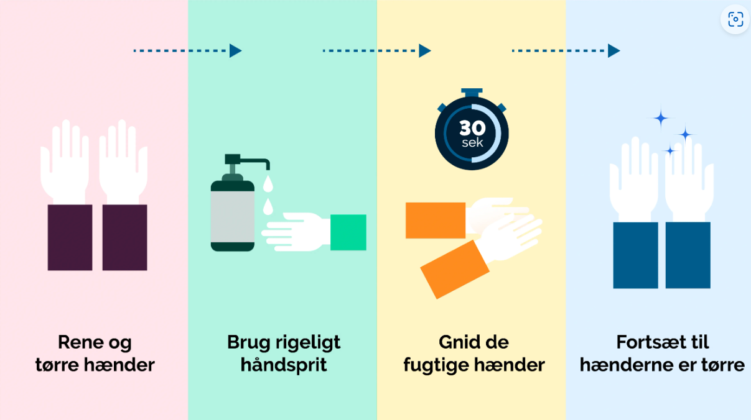
Inspiration material to safety moment Danish Health Authority recommends
Danish Health Authority - good advice to prevent infection
Reference: https://www.sst.dk/da/viden/Forebyggelse/Hygiejne/Rene-haender/Haanddesinfektion
If a hand sanitizer dispenser in shared areas is empty. Please write to: cas-ren@dtu.dk If a hand sanitizer dispenser in shared areas is empty. Please write to: XXXX

