Slide 1
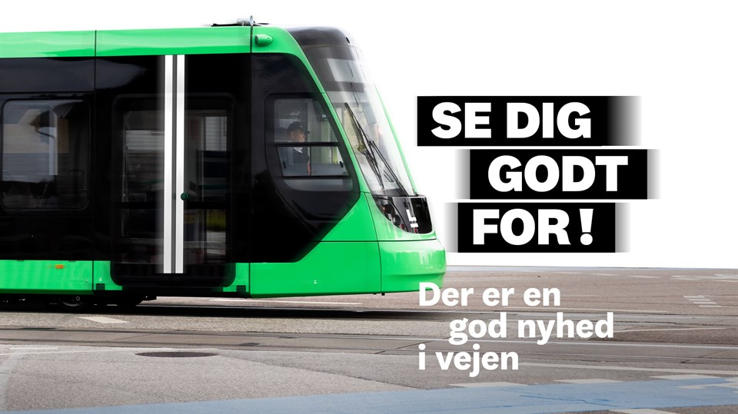
Safety Moment - The light rail at DTU
Follow traffic laws
Respect signs and traffic signals
Look up from your mobile phone
Take the music out of your ears
Do not drive onto the track
Look carefully before you go
There is good news on the way
Notes:
Sikker trafik omkring letbanen
Se dig godt for
Følg skilte og lysregulering
Kør ikke ind på sporet
Tag musikken ud af ørerne
Følg færdselsloven

