Slide 1
Safety Moment
Work-life-balance

Slide 2
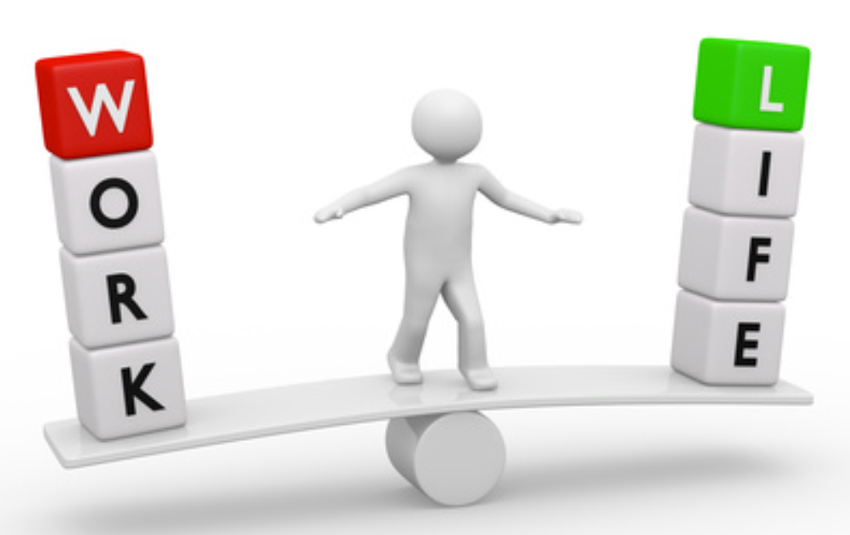
Safety Moment
Work-life-balance
Boundless work and more working from home have given work-life-balance a new dimension.
We manage our own time, and we have the freedom to plan working hours and tasks. The flexibility provides motivation, well-being and energy in everyday life, but can also break down structures and cause blurring of boundaries between work and private life.
Therefore, find a strategy so that you get your work life and private life in balance.
Plenary debate:
How is your balance between work
and private life?

Slide 3

Safety Moment - Work-life-balance
Here are 5 tips:
Set frames and structure for your workday
Align your working hours and expectations with your manager and possibly closest colleagues with whom you share work assignments. When are you expected to be available and, for example, answer emails and phone calls.
Plan your working hours as well as breaks
Use your calendar to manage your tasks and time. If your schedule is slipping, lay out a new plan. It gives peace of mind to what you are working on now. Remember breaks should also be booked in your calendar.
Know your rhythm
Complicated tasks require you when you have the most energy and focus. Do you perform well in the morning, then do your most important tasks there. Or if you write best after a walk, set aside time for that. Find your own rhythm and plan your day based on it.
Finish your workday
End your workday well by finishing 10 minutes before closing time. Write down and make a plan for what
takes up your mind so that you not only close down the computer, but also the work tasks in your head.
This allows you to recharge better and be efficient again the following workday.
Take time off when you take time off
Prioritize your private life and avoid working, e.g. check text messages, emails, etc., when you
take time off.
Turn off emails completely on your phone, or alternatively at least turn off notification sounds.

