Slide 2
Dialogue i LSU (2022)
– working day flexibility

Slide 3
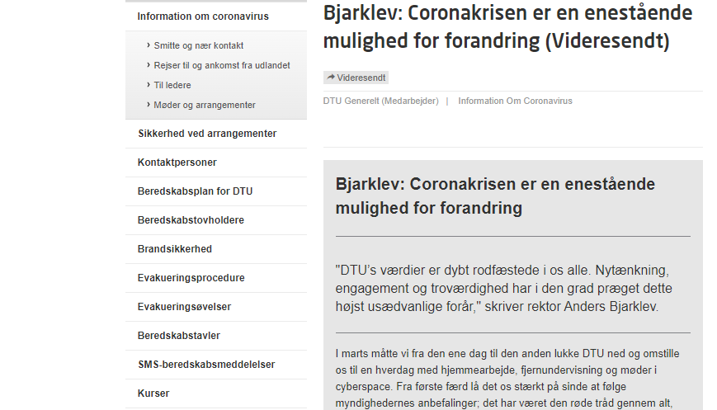
Summer 2020
Bjarklev: The coronavirus crisis is a unique opportunity for change
DTU’s values deeply rooted in us
  Innovative thinking
  Credibility
  Commitment
Everybody’s different
We’ve succeeded in maintaining high productivity

Slide 4
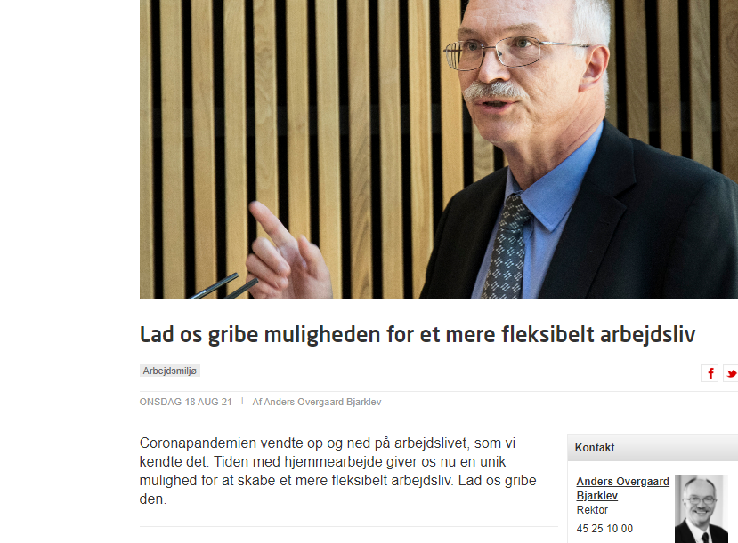
Summer 2021
1. August 2021:
Anders Overgaard Bjarklev, President
The coronavirus pandemic turned our familiar working world upside down.
The time we’ve spent working from home has given us a unique opportunity to create a more flexible working life.
Let’s seize that opportunity.
”
Read more on DTU Inside, and click here for a link to the sub-policy for workday flexibility
Notes:
Attraktiv arbejdsplads, der kan tiltrække, udvikle og fastholde de bedste medarbejdere
Desuden er DTU’s ledelse opmærksomme på at de svære arbejdsvilkår under corona ikke kunne afløses i faldende produktivitet, innovation, krativitet etc.

Slide 5
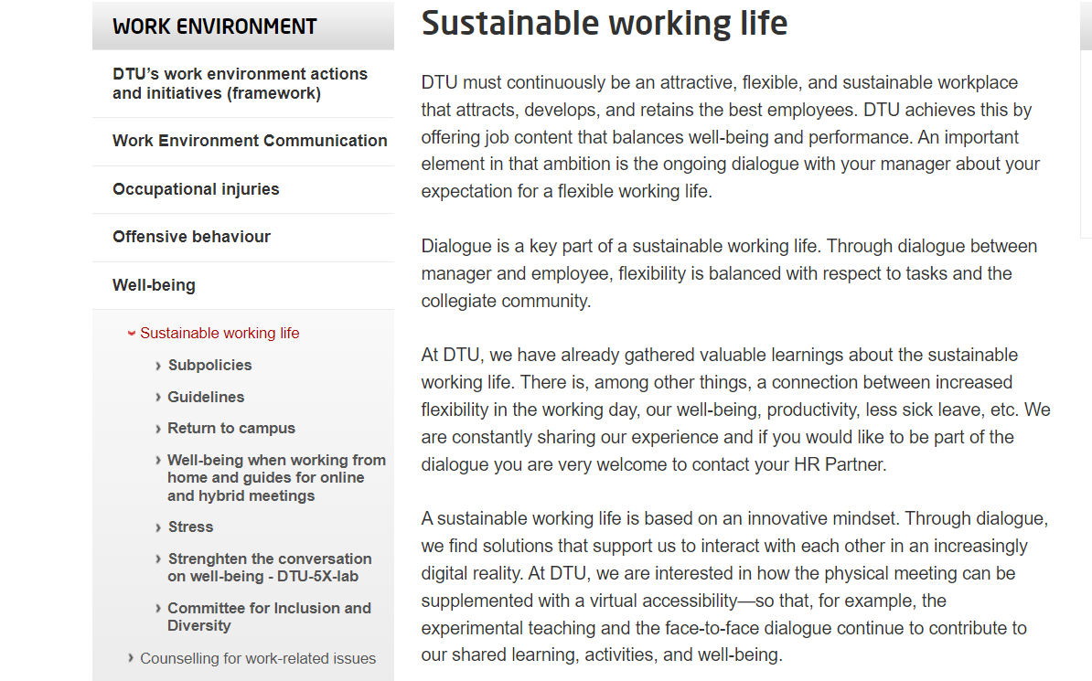
Susstainability are also about
Worklife balance
Get involved in the dialogue
Be virtually available
Notes:
Alle har ret til en dialog med egen leder og ønsker til fleksibilitet.
I den dialog er det oplagt at komme omrking disse tre emner

Slide 6

Working day flexibility works both ways
Flexibility is balanced with due consideration for
  Work tasks
  Sense of community among colleagues
Basic trust in
  Each individual acting responsibly within his or her own area of responsibility
Dialogue is an important part of a sustainable working life to ensure that we each learn more about what motivates us

Slide 7


What is new?

Slide 8
Change in mindset (culture)
Physical presence
Working from home is a ‘bargained’ employee right
Fixed hours, office hours, contact hours
Performance is linked to presence
Absence (either / or)
Guidance/sparring (when we can meet on campus)
Etcetera
Virtual availability
Working from home is a part of a sustainable working life
Availability, updated calendar, contact number, etc.
Performance is linked to creation of results
Absence (both / and)
Guidance/sparring (time dedicated in the virtual space)
Etcetera

Slide 9
Evaluation of sub-policy for workday flexibility

Slide 10
Evaluation of sub-policy for workday flexibility
  Number of people who took part in the survey: Around 1200 (19 April - 2 May)
  20% said that, in general, their job requires them to come to work
  77% said that, in general, their job does not require them to come to work
  3% didn’t respond
  Distribution of answers across job categories
  63% technical/admin staff (TAP)
  26% scientific staff (VIP)
  11% PHD
  Distribution of answers across roles
  10% managers
  90% employees
  All units are represented in the survey
  Most respondents took the opportunity to make an open comment

Slide 11
Trends - options
I can feel that it gives me more energy for work and personal life—work/life balance. I’m very happy with my workplace and my colleagues and so I’m also happy to show up in person.
Flexibility
Work/life balance
Saved commuting time
Trust / legitimate
Attractive workplace
I’m really glad to have the opportunity to be able to work from home. I can do almost all my work tasks from home.
I spend the two hours I save on commuting on exercising
I’m glad that my manager and DTU are keeping up with the times and have caught on to the good things that the lockdowns have brought.

Slide 12
Trends - pitfalls
Maintaining social relations requires some action centrally.
Challenging to create a sense of community
Difficult start for new colleagues
Blurred boundaries
My manager prefers physical attendance
Colleagues are not available
I work too much when I work from home.
I miss bouncing off ideas at the ‘coffee machine’
It’s hard for managers to let go; it’s more reassuring when you can physically see your employees in the office.
The pitfall can be an old-school view of the workplace and problem-solving on the part of management, which makes you want the employees to be physically present, because that gives management a sense of having better control over the employees and the work that’s being done.

Slide 13
Flexibility is experienced differently (not representative)
At our department, the administrative staff are back to the old normal, there are no increased options for working from home after February 2022.

Slide 14
... and is also about leadership.
Those who already struggle with job satisfaction may find it difficult if the framework is too flexible.
Those who are passionate about their job can get SO much more out of their work and private lives with a flexible framework with more working from home.
The key is letting go, then you see who thrives and who might need some support to cope with the very flexible framework, rather than letting the few prevent the majority from becoming more productive.

Slide 15
DTU campus - is your primary workplace

Slide 16
Flexible work arrangements

Slide 17
Your work performance - are about results

Slide 18
Virtual collaboration - requires practice

Slide 19
Absence, child sickness etc.

Slide 20
Next step: Dialogue in LSU (Local Collaboration Committee)
What is the attitude of our LSU towards the increased possibility of flexible working arrangements that the Executive Board is proposing?
What initiatives can we as a LSU carry out to support a more flexible work arrangement?
How do we balance our different wishes for flexibility with the fact that we’re all part of a working community?
How do we ensure a sense of unity now that we’re seeing less of each other in the physical workplace?
What are the opportunities - and what do we risk losing when we increase flexibility?

