Slide 2
Sexism
Background, concepts and nuances

Slide 3
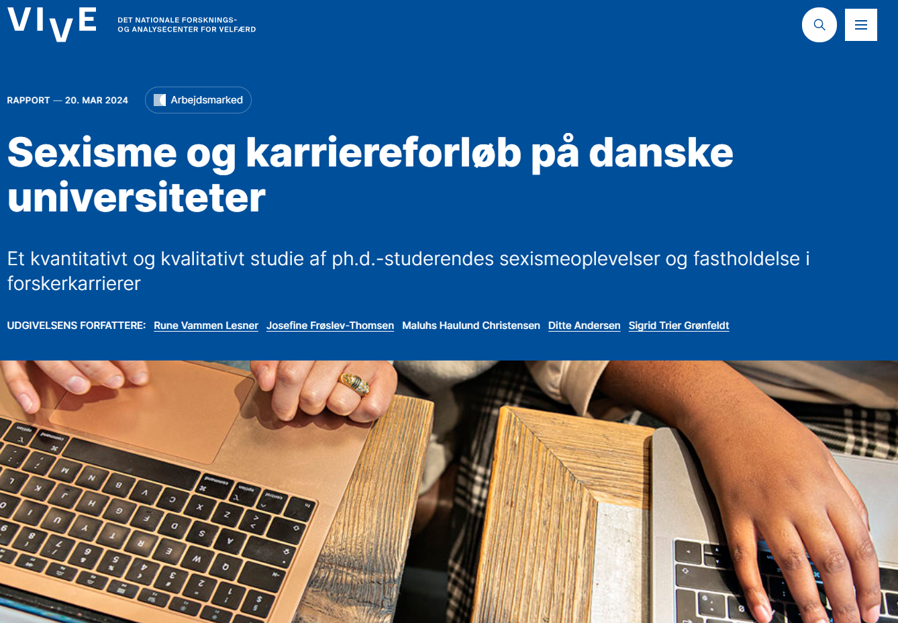
VIVE rapport (spring 2024)

Slide 4
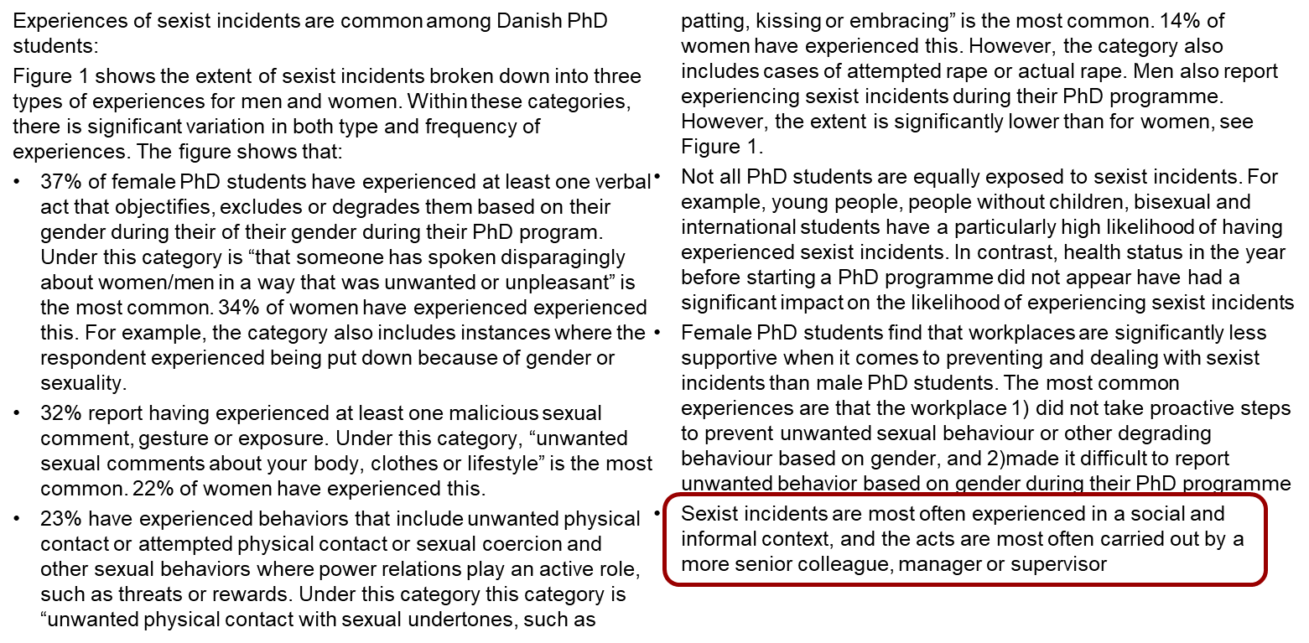
VIVE rapporten (extract)

Slide 5
VIVE rapport (extract)
Female PhD students experience four main forms of sexism
Everyday sexism and subtle sexism, which is expressed in patterns of communication and interaction, such as men getting more speaking time and their work is met with more respect and recognition.
Well-intentioned sexism, where seemingly good intentions to spare women, for example for the sake of their caring role as a mother, means they miss out on demanding work tasks that could give them the opportunity to demonstrate competence and perform well.
Gender-based discrimination, such as women doing more academic service work, or that male applicants are preferred because of concerns about women going on maternity leave.
Hostile sexism and sexual harassment, which includes explicit and abusive incidents of either a verbal or physical nature.

Slide 6
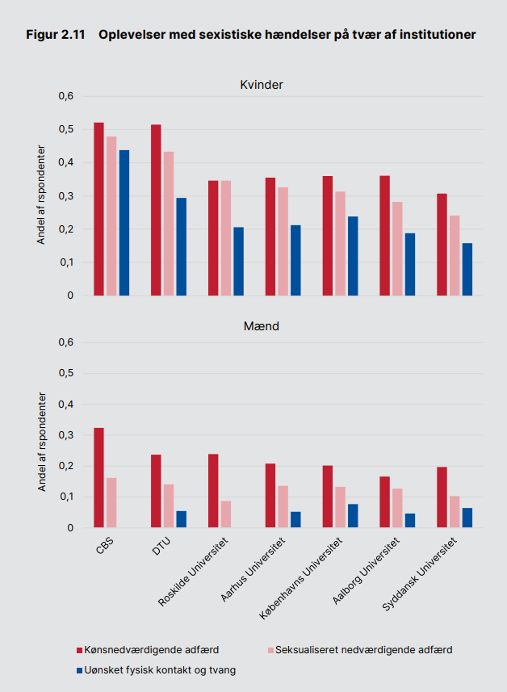
VIVE rapporten (extract)
Among PhD students affiliated with the institutions CBS and DTU, many have experienced sexist incidents.
Source: VIVE report, p.39

Slide 7
VIVE rapporten (DTU executive board)
The VIVE report makes an impression, we acknowledge the findings and the conclusions call for reflection and action

Slide 8
Sexism, what is it?

Slide 9
Sexism (definition)
“Sexism is any action, gesture, visual representation, spoken or written word, practice or behavior based on the idea that a person or group of persons is inferior because of their gender”
Reference: Council of Europe #Stop Sexisme

Slide 10
Sexism as a concept (example)
Sexism is a prejudice or discrimination based on gender
For example, it is sexism when
a woman is deselected as a project manager for an EU project because it is estimated that she will soon have children
or if someone speaks of men who cry or show emotion in a condescending manner

Slide 11
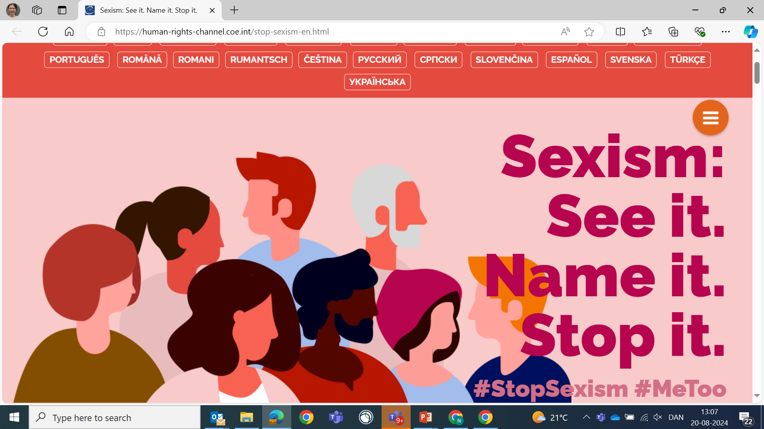
You can
Styrke dialogen om, at sexisme er her
Træne vores blik til at se sexisme
Fremme modet til at tale om sexisme
Tilbyder værktøjer til at arbejde proaktivt med sexisme
Værktøjer (for proces spørg HR)
DE&I dialogkort (link til virtuelle kort der kan bladres i)
Dare to care: How to get started (vedhæftet pdf)
DTU & Monopolet
DTU Trivselsdialog
DTU Ledelsesdialog
DT arbejder med sexisme ved at

Slide 12
You can work with sexism by
Strengthen the dialogue that sexism is present
Creating an awareness about sexism in order to identify it
Promote the courage to talk about sexism
Offers tools to work proactively with it
Notes:
Everyone has a responsibility to strengthen the dialogue about sexism (contribute to psychological safety), BUT managers, TR, AMR and AMK have a special responsibility to articulate it.

Slide 13
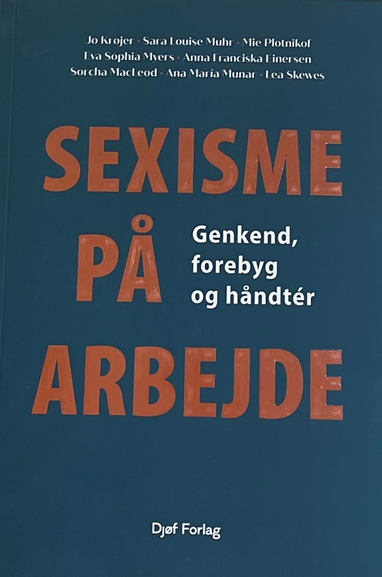
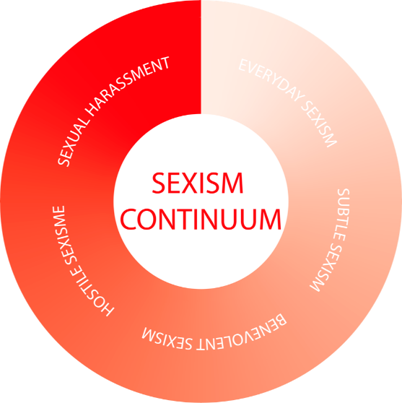
Sexism is about gender (English versus Danish)
Sexism concerns all of us
Sexism is in our culture
Sexism is a continuum

Slide 14
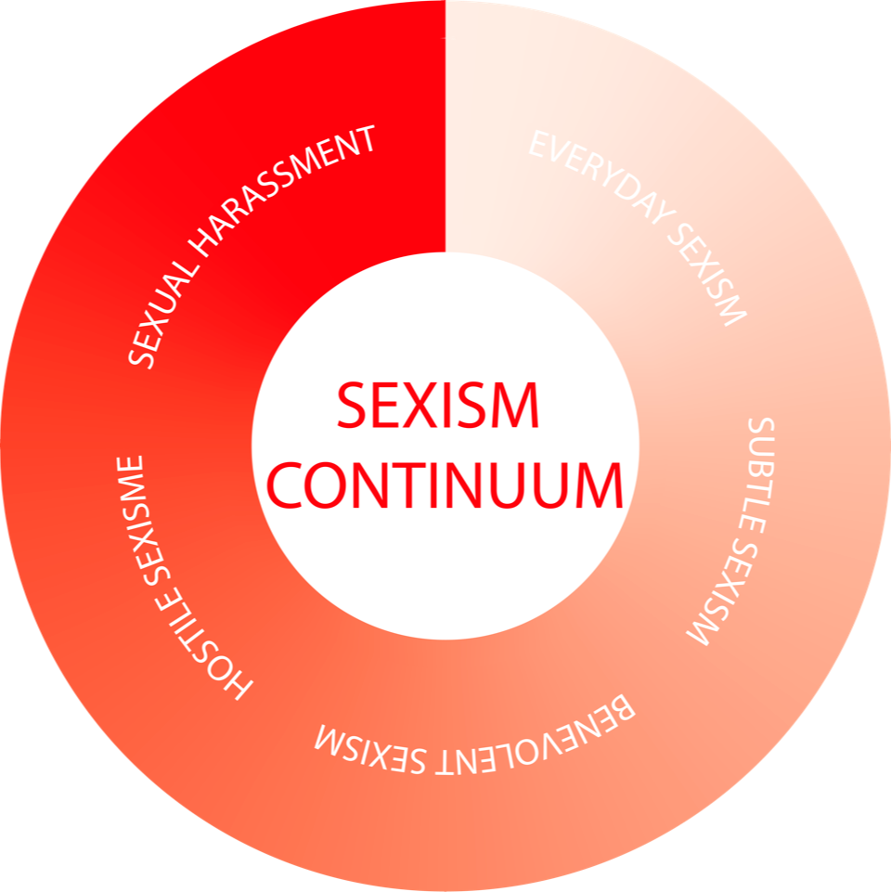
Sexism is a continuum
  Far between e.g. everyday sexism and hostile sexism
  BUT: The factors reinforce each other
  AND: The transitions are difficult to see
Sexual harasment
Everyday sexism

Slide 15
Sexism is a continuum
The transitions are difficult to see, but the outer points are clear ...
Behaviour that can be seen and "more easily" documented
"Duty to investigate", interviews of witnesses, mapping of the course of events, etc.
"Easier to establish a common consensus that it is unacceptable
Tendency to externalize (you shouldn't put up with that, it should have consequences)
More subtle behaviors that are difficult to "see," recognize, and document
A feeling, a gut feeling, something that was not said but thought (unconscious bias, subtly formulated, etc.)
Difficult to establish "common” agreement that it has happened
Aren't you a little delicate, that's just the way he is, it's the tone etc.
Tendency to turn it inward (it's probably just me)
Sexual harasment
Everyday sexism

Slide 16
The many expressions of sexism (examples)
Sexual harassment
At DTU, often referred to as offensive behavior
Unacceptable (process of handling)
Everyday sexism
Being spoken to in a derogatory way
Being noticed because of their gender
Hand on thigh, often in informal and social settings
Extreme attention, e.g. in connection with stalking (both work and private)
Unpleasant situations where there is often an unequal power relationship and where women are often a minority
Being presumed to be identical with other people of the same sex
Being assessed as less qualified for a task
Subtle sexism
To have been overlooked
Having been treated condescendingly because of gender
To cast doubt on abilities
Being excluded because of gender
Hostile sexism
"You're going to be very shrill"
Think there is a need for a man here (technique, physical or dirty work etc.)
Well-intentioned sexism
"Congratulations, you are our youngest female professor"
I would like to spare you from being lead (after maternity leave)
Well done that you can stand being a male laboratory technician
Unbelievable how quickly she has become a professor
Take it like a man (pack your feelings away)

Slide 17
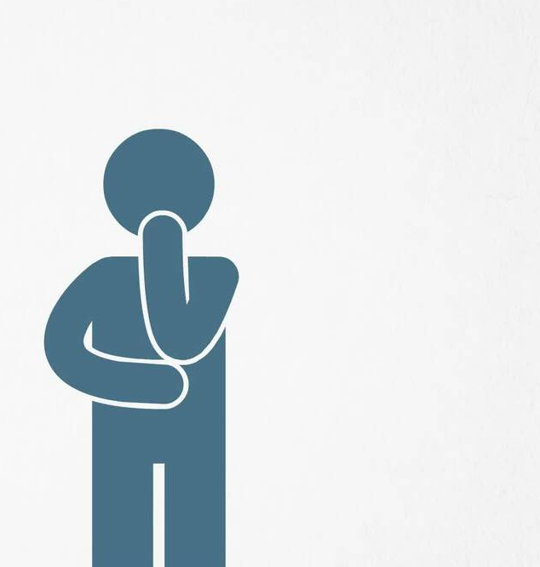
Reflection (individual)
What are your own thoughts about sexism
What have you paid attention to in your culture?
What would you call it (what is sexism about)?
How can you work with sexism (what can you start doing yourself)?

Slide 18
You can work on sexism by
Creating opportunities to talk about sexism (LSU, AMU, joint meetings, over lunch, etc.)
Say it out loud when you see sexism
Be brave, also to talk about what can only be sensed (e.g. the subtle)
Put on gendered “glasses” when you use
some of the DTU dialogue tools

Slide 19
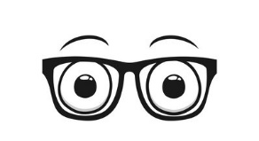
DTU dialogue tools (ask HR for more info)
DEI card (orange)
Dare to care: How to get started
DTU and the Panel
DTU Well-beeing Dialogue
DTU Leadership Dialogue

Slide 20
What is DTU (already) doing

Slide 21
Sexism: What is DTU doing today that we need to do more of in the future ...
DTU Well-being Dialogue (supplemented in 2024 with DEI cards)
DTU Leadership Dialogue (to be initiated in the autumn of 2024, occasion for dialogue on e.g. bias)
The cooperation and working environment organization (initiated, but requires sustained efforts)
DE&I is highlighted in the UMV template (updated in 2024)
DE&I workshops (requested by the departments on an ongoing basis)
DTU Leadership Programme (has strengthened focus on DE&I)
Network for actors who work with offensive behaviour (participants are happy to engage dialogue 1:1)
FORDI (Forum for Diversity and Inclusion is revitalized in the spring of 2024)

Slide 22
Offensive behaviour
Can be about many other issues than sexism
Extra material (independent page on DTU Inside)

Slide 23
Offensive behaviour
Can be many other issues than sexism (gender)
At DTU, we do not accept offensive behaviour
By offensive behavior, DTU understands that you are exposed to unpleasant or degrading behavior that you find difficult to defend yourself against.
Talk about it if you have experienced offensive behaviour
When we experience incidents that are difficult to defend against, DTU encourages an open dialogue about what you are experiencing
The open dialogue is crucial for DTU to be aware of, and to be able to prevent and handle offensive behavior
If you have experienced an offensive situation, you have several options
At DTU Inside, there are a number of contact options
The most important thing is to choose someone you trust
Anonymous registration is also possible through DTU's psychological counselling
Psychologists are subject to a special statutory duty of confidentiality
Your registration does not in itself activate any form of action

