Slide 2
Guest Researchers and Guest PhD students
Table of Contents
Guest Researcher System - Who should register in the system?
Definitions
DTU guidelines regarding Guest PhD’s and CSC funding
Guest Researcher System – Administration - Process
Guest Researcher System – Non-EU citizens
Guest Researcher System – Information to the Guest
Guest Researcher System – Expiry of guest stay/work permit
HR contact info
Page:
3
4
5
6
7
8
9
10

Slide 3
- Who should register in the Guest Researcher System?
Guest Researchers and Guest PhD students
Who should register in the Guest Researcher System?
Unpaid guests above PhD level who will come to Denmark/DTU.
All guests (above PhD level) who are not to be paid by DTU and who will work/contribute to the output of DTU in any way. Data that is generated at DTU/is used by DTU in a way that DTU benefits from it.
If the guest is not at a PhD level or above (e.g Master students) then the guest must contact AUS (Office for Study Programmes and Student Affairs) for their process. You can read more about International guest students under AUS at DTU Inside here.

Slide 4
Definitions
Guest Researchers and Guest PhD students
Guest researcher = not employed in Denmark - but will conduct research at a Danish research institution or company who are putting their research facilities at the guest researcher’s disposal. The guest researcher much have completed an educational programme at the level of a Master’s degree or above.
Guest PhD students = are enrolled in a PhD programme abroad/in their home country and wish to do a part of their PhD programme in Denmark.
Work = A person takes part in creating a product or changing a product or contribute to the output of a company in any way.
Non-EU citizen: Will need a Danish work and residence permit if the person is to work in Denmark regardless if the person is paid or unpaid from Denmark. The Danish work and residence permit must be issued before the person can start work.
(If a non-EU citizen is living in another EU Schengen country-and have a residence permit to this country- the person can enter Denmark (as a tourist), but the person is not allowed to work in Denmark on a work and residence permit issued by another country).
EU citizens: Can enter and work in Denmark without a Danish work and residence permit. They need an EU residence document if they are to live in Denmark for more then 3 months in order to receive a CPR number.
Nordic citizens: Can enter and work in Denmark without a Danish work and residence permit or an EU residence document.

Slide 5
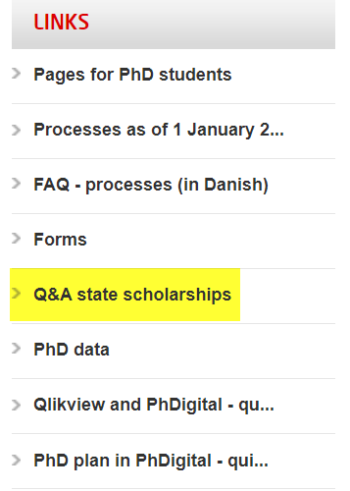
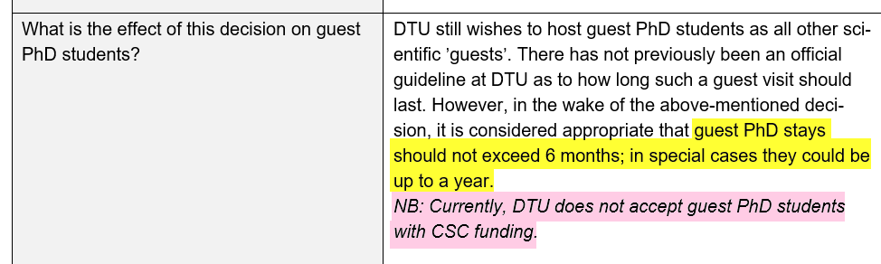
DTU guidelines regarding Guest PhD’s and CSC funding
Visits from Guest PhD students at DTU should not exceed 6 months.
At the moment DTU do not accept guest PhD students with CSC funding.
You can read more about the guidelines in the Q&A state scholarships at DTU Inside (here; https://www.inside.dtu.dk/en/undervisning/administration/phd-uddannelse-administration/administration in the fact box “LINKS”)
Second last question on page 3 of the document:

Slide 6
Guest Researcher System – Administration - Process
Guest Researchers and Guest PhD students
The guest and the department/DTU contact person has communication regarding a visit. If they agree on a visit the guest register in our Guest Researcher System.
Guest Researchers and guest PhD students register in our Guest Researcher System via this link; https://guestresearcher.dtu.dk/
The person the guest has written to be the contact person at DTU (needs to be a DTU e-mail for the person, if not an error will appear) will get an e-mail from the system with a link to approve or reject the guest’s visit.
- If the DTU contact person approves the visit the DTU contact person are asked to write the e-mail of his/her manager and the manager will receive a notification that the DTU contact person has approved the visit including dates of the visit.
- If the DTU contact person approves the visit HR will get a notification about the visit and can start the process with a work permit if needed and send a standard invitation letter to the guest.
Please note when approving the visit you will be ask to fill in a purpose of stay. The purpose of stay will be merged into the invitation letter automatically, so please write a few sentences about what the guest will be doing during the visit at DTU.
If the DTU contact person rejects the visit the DTU contact person will need to write a reason for the rejection. The reason will be sent to the guest automatically.

Slide 7
Guest Researcher System – Non-EU citizens
Guest Researchers and Guest PhD students
A non-EU citizen can register a start date in the Guest Researcher System which is 2½ month into the future at the earliest. This is to ensure there is enough time to apply for a Danish work permit.
All (non-EU) Guest PhD students needs to apply and obtain a valid Danish work permit before coming to DTU regardless of the length of the stay.
Guest Researchers (who has a Master degree as a minimum) who is to stay less then 90 days might be exempted from a work permit. This needs to be assessed individually in each case.
It is only possible to come on the exemption of a work permit once for each position offered by an employer/host.
We need a copy of the Master or PhD diploma before the start date. If the diploma is not in English, then translated into English by an authorized translator.
The guest will need to confirm to HR that the guest fulfill the short-term visa requirements before the visit. HR will send an e-mail with the rules to the guest.
If a guest can come without a work permit but needs a visa (business or tourist visa) in order to enter Denmark, the DTU department hosting the guest is to assist with the visa if needed (visa guide on DTU Inside).
If the desirable start date is not possible to choose when registering, then the guest should write the desirable start date in the comment field when registering in the system and HR will assess if this is possible.
If a guest already have a Danish work and residence permit, the guest should upload a copy of the permit when registering in the system.

Slide 8
Guest Researcher System – Information to the Guest
Guest Researchers and Guest PhD students
After the DTU contact person has approved a visit, the guest will receive this informtion from HR:
Guidance on how to apply for a Danish work permit (for non-EU citizens) or an EU residence document (for EU citizens)
Invitation letter
In the in mail/guidance there will also be a link to our DTU’s Welcome Guide, where the guest can read more about housing, CPR number and much more.

Slide 9
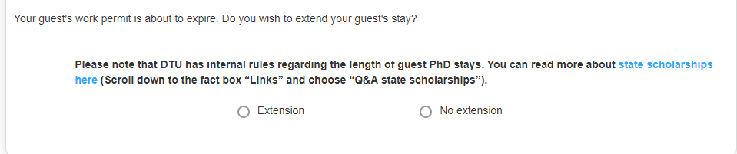
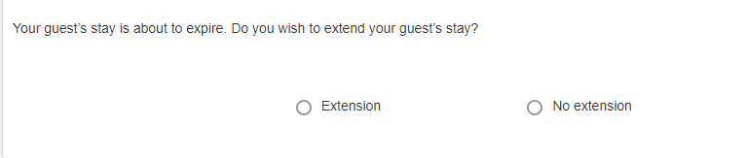
Guest Researcher System – Expiry of guest stay/work permit
Guest Researchers and Guest PhD students
3 weeks before a guest stay’s end date or work permit expires the Guest Researcher System will automatically send a mail/notification to the DTU contact person cc the shared mailbox (guestresearcherXX@dtu.dk) which the department secretaries has access to.
In the mail/notification there is a link to a Sharepoint page where you need to chick of if the stay should be extended or if the stay will end as planed (no extension) e.g:
It is important to register if there should be an extension or not.
HR will only be notified of an extension if you register it via the link.
It is very important we apply for an extension of the work permit (for non-EU citizens) before it expires!
Please note we can only extend a visit if there is an academic reason for it. This is for you/the DTU department to assess.

Slide 10
HR contact info
Guest Researchers and Guest PhD students
If questions please contact your department secretaries first
You are also welcome to contact us in the Work and residence permit team at HR
Our team phone number is: (+45) 45 25 83 00
For case specific questions you can contact us at; wr@dtu.dk
Contact us regarding the Guest Researcher System (errors, user issues and other comments to the system) at guestresearcher@dtu.dk
It is very important that you inform Corporate HR (wr@dtu.dk) if there are any changes regarding your guest’s stay. E.g. new period, cancellation etc.

