Slide 2
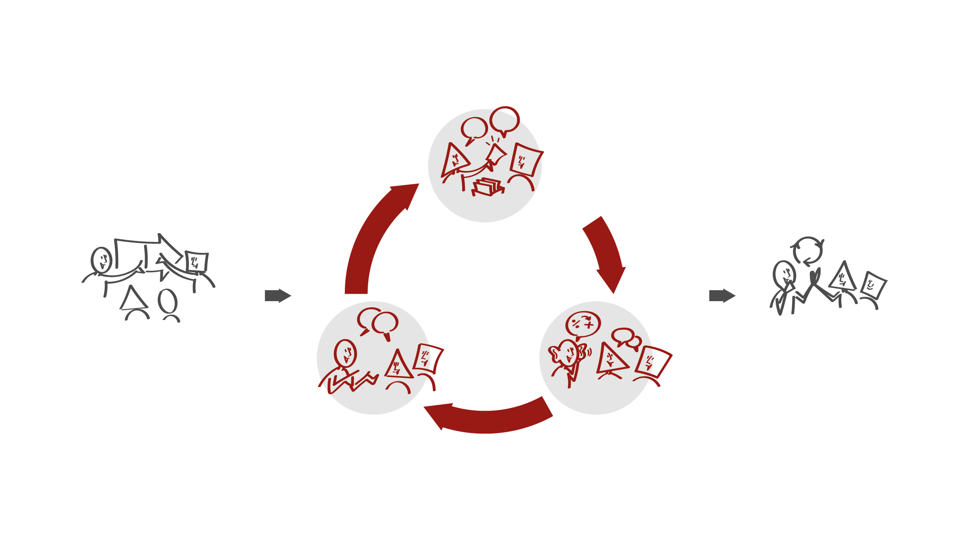
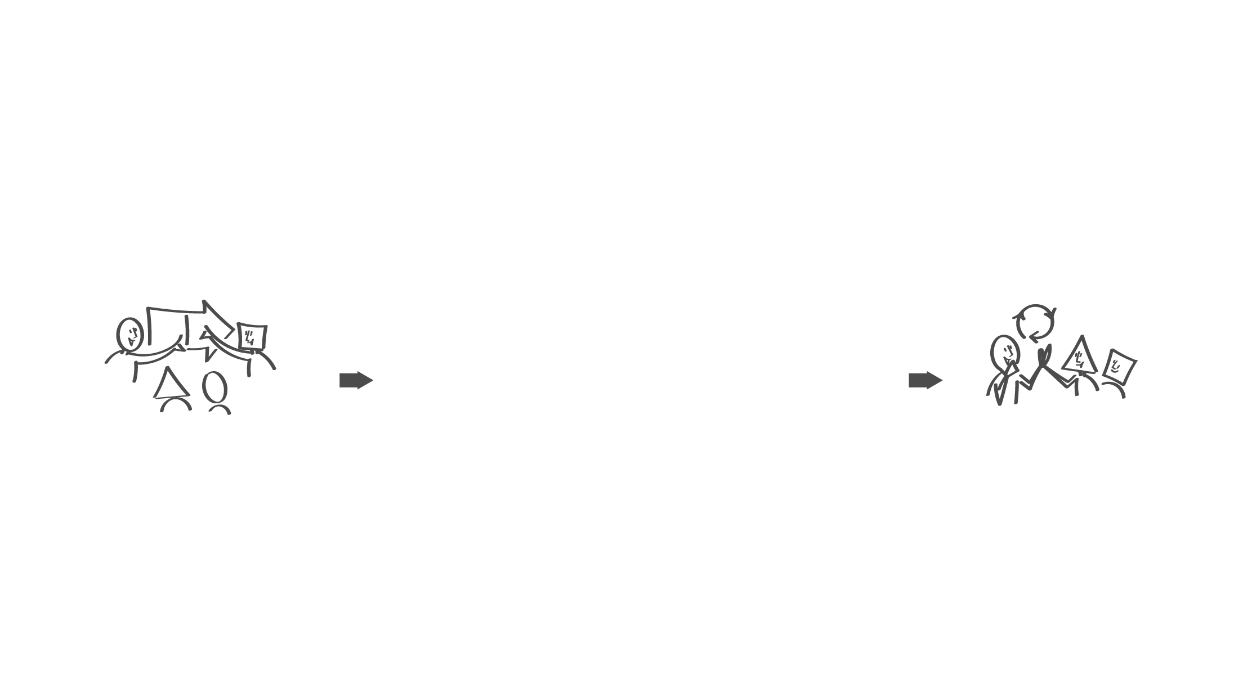
  Step 2 - The manager does not participate
Employees have a dialogue about experienced leadership behaviour using the leadership dialogue cards
HR partner facilitates
Getting ready (before)
Next step (after)
Step 1 - The manager participates
Manager shares own dialogue cards
Invites to dialogue and asks for feedback
Step 3 - The manager does not participate
Manager listens
Invites to further dialogue

Slide 3

Step 1 - The manager participate
What will happen
The manager sets the framework of the meeting Introducerer DTU Ledelsesdialoger
Shares the choices of own three cards ​
Presents own thoughts about future leadership development
Guiding questions
The manager shares own thoughts about:
What do I want to achieve with my leadership?
Where is our unit heading?

Slide 4

Step 2 – The manager does not
participate
What will happen
Employees take turns ​and share their choices of dialogue cards
Clarifies why they have chosen each particular card​
HR facilitates (three rounds)
Guiding questions
Employees give input to continued dialogue:
What is appreciated?
What can the manager tone up and down?
How can the employees contribute to strengthen the cooperation?

Slide 5

Step 3 – The manager participates
again
What will happen
The employees share: Clarifies why they have chosen each particular card​
Supports the dialogue e.g. by repeating what is being said
Invites to further dialogue
Guiding questions
What is important for the employee to share?
Which input do the employees wish to share about, what the manager can tone up or down​?
Which input do the employees wish to share about; how they can contribute to strengthen the cooperation?

