Slide 1
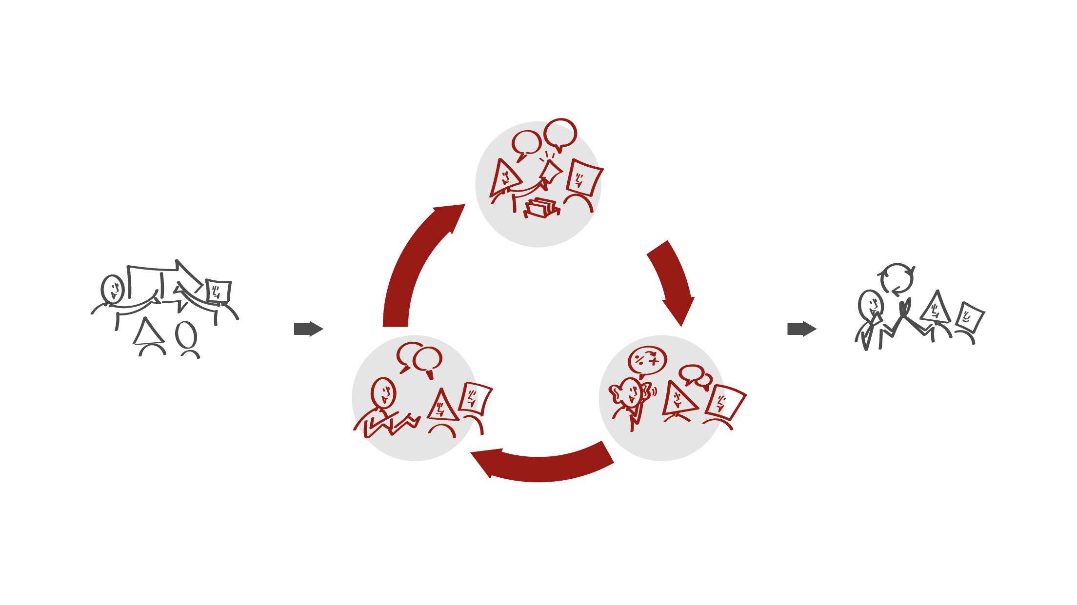
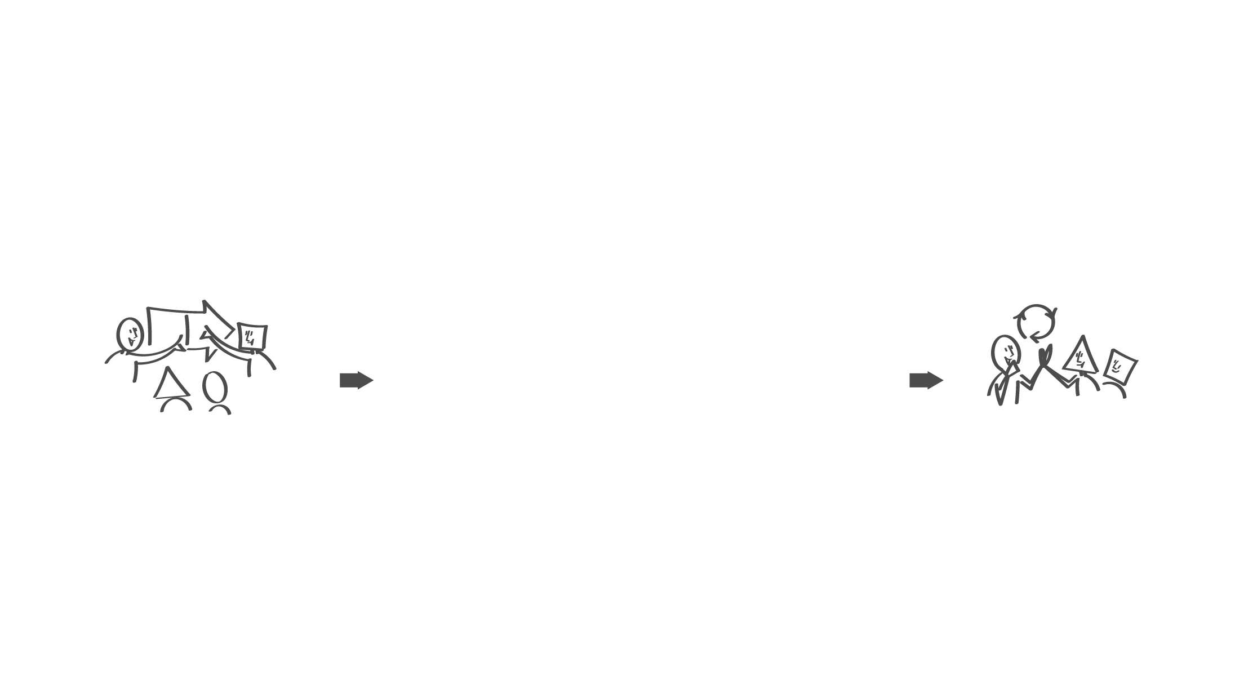
Step 2 - The manager does not participate
Employees have a dialogue about experienced leadership behaviour using the leadership dialogue cards
HR partner facilitates
Getting ready (before)
Next step (after)
Step 1 - The manager participates
Manager shares own dialogue cards
Invites to dialogue and asks for feedback
Step 3 - The manager participates
Manager listens
Invites to further dialogue

