Slide 2
Map your diversity, equity, and inclusion in your unit
Group exercise

Slide 3
Process for the Exercise
1.
Group dialogue
(45 min.)
2.
Individual reflection
(15 min.)
3.
Dialogue (2+2)
(30 min.)
4.
Plenary session
(min. 25 min.)
5.
Next step
5 A. We will not continue for now and will let the exercise stand alone.
5 B. We set up one or more working groups to continue working on a selected theme (themes).
5 C. We decide which themes we will bring to the next LSU/work environment group meeting (e.g., how can the office be arranged to ensure everyone thrives as much as possible).
5 D. We select one or more themes and ask our leader to put them on the agenda for the next joint meeting.
5 E. Another next step that we come up with ourselves.
Notes:
The step that has been pre-selected as the next step remains, and the appropriate time is inserted. The rest of "5" is deleted.

Slide 4
Group formation
Notes:
Minimum four people in each group

Slide 5

Group dialogue
1.
1
Each of you selects three cards that say something about your experience with diversity, equity, and inclusion in your unit (the cards can be interpreted freely).
Conduct three rounds, where participants take turns elaborating on their choice of cards (one card per round). The group can ask questions about the card without judging or discussing it.
2
3
3
Notes:
Everyone gets a set of cards and chooses three cards that say something about their personal experience with diversity, equality, and inclusion. The statements on the cards are both negatively and positively worded. You add your own interpretation by, for example, stating that you experience the opposite of the formulated statement.
There are different methods to select the three cards:
Some prefer to brainstorm individually before looking at the card statements,
Some prefer to lay all the cards out on the table, and
Some prefer to choose cards as they go through the pile, ultimately selecting the three most important ones.
There are three rounds, where participants take turns sharing their cards (one per round) and elaborating on why they chose them. The others in the group can ask questions (without judging or discussing).

Slide 6

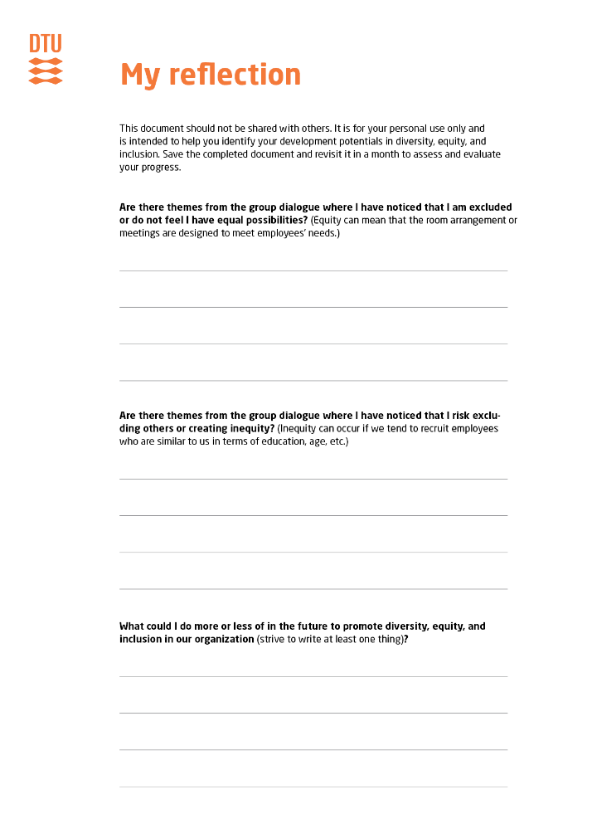

Own reflection
Notes:
Each participant is given the document “Own Reflection," which is filled out individually and not shared.

Slide 7



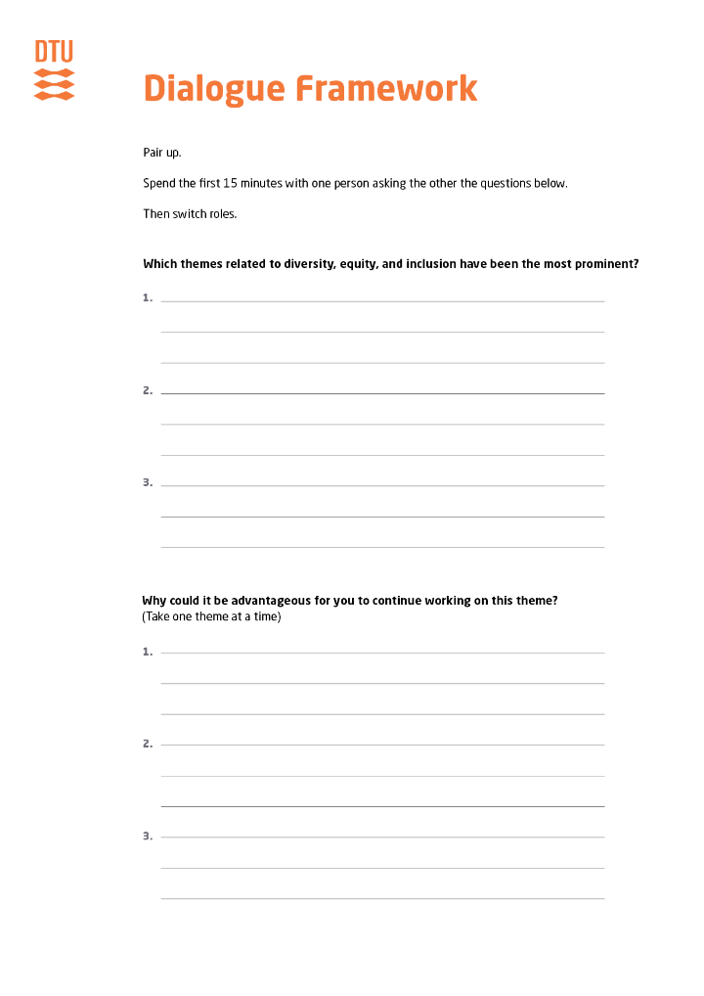
Dialogue
Pair up two by two.
Ask each other questions based on the “Dialogue Framework" (15 minutes per participant).
Notes:
Participants pair up two by two. The " Dialogue Framework" is handed out to everyone.
The groups take turns asking about themes based on the "Dialogue Framework".

Slide 8
Plenary session
The original groups come back together.
In the groups, a secretary and a presenter are selected.
You take turns sharing what you have come up with in the two-person groups, while the secretary writes it down on the summary sheet (15 minutes).
The facilitator asks each group to present: 1. What the groups have chosen to highlight as important themes. 2. And why they are important.
The summary sheets are then hung on the wall.
Notes:
Distribute the "Summary Sheet" to each group. (5 minutes per group presentation)

Slide 9
Next step
Notes:
Insert the next step you have chosen (see under process, 5 A-E).

