Slide 1
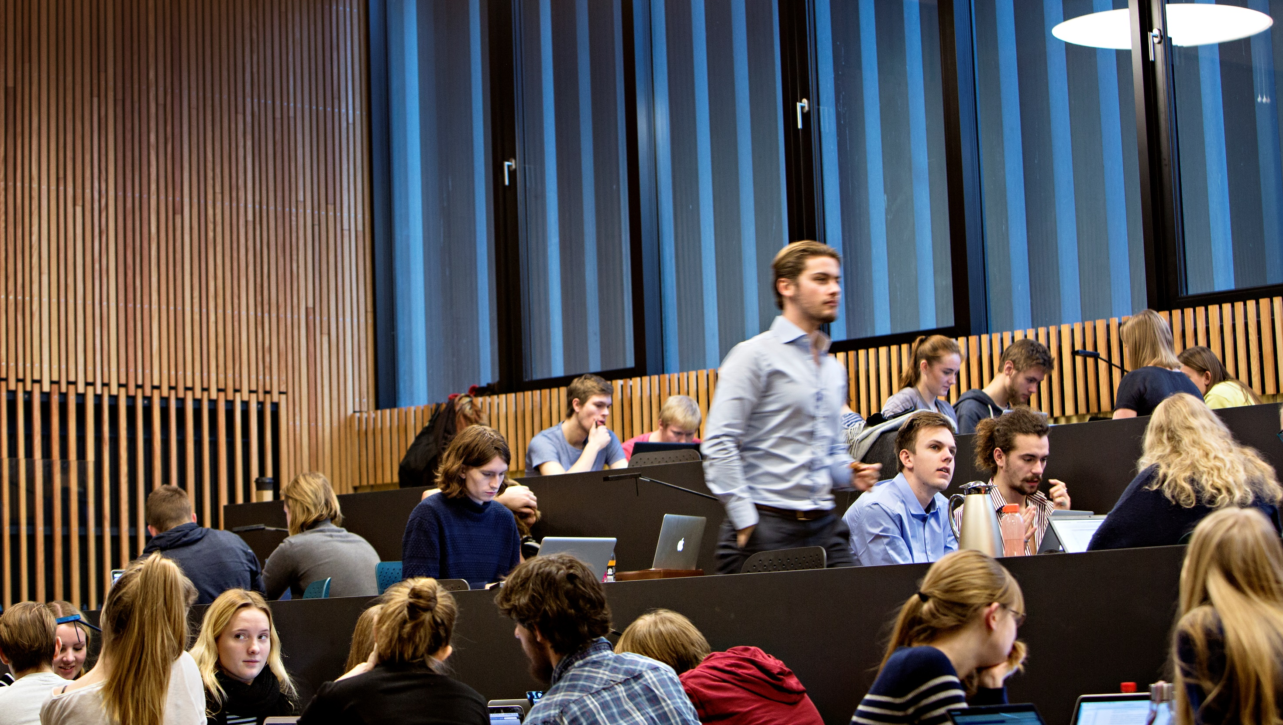
The Polytechnical Foundation

Slide 2
Why consider a Polytechnical Foundation?
Complex global challenges requires engineers with:
  A mathematical, natural scientific and technical scientific expertise
  A digital mindset with a focus on measuring, handling and analyzing data
  Understanding of the context engineers are developing technological solutions for.
The polytechnical foundation contains courses that provide all graduates with a Bachelor and Master of Science degree in Engineering a solid common scientific foundation for developing technological solutions to address complex, global challenges.

Slide 3
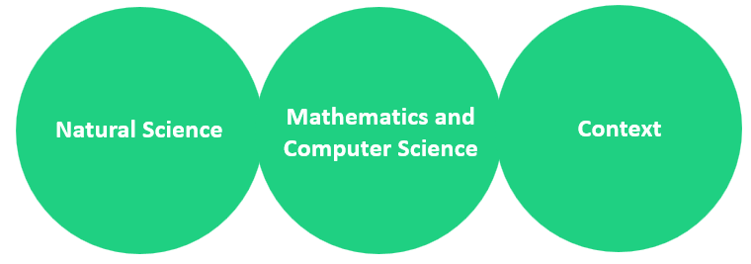
The content of the Polytechnical Foundation
A selection of courses and competences common for everyone on combined BSc and MSc programmes at DTU.
Natural Science: courses in physics, chemistry and bioengineering (20 ECTS)
Mathematics and Computer Science: Mathematics and courses in programming and statistics (30 ECTS).
Context: courses in sustainability, innovation and the understanding of the impact of technology on society (15 ECTS)

Slide 4
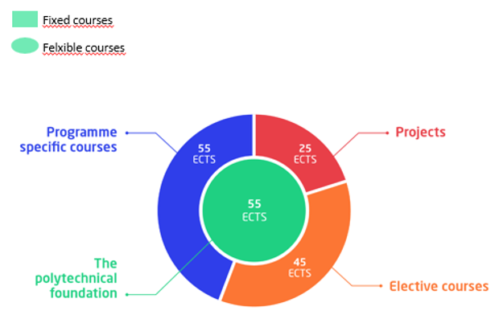
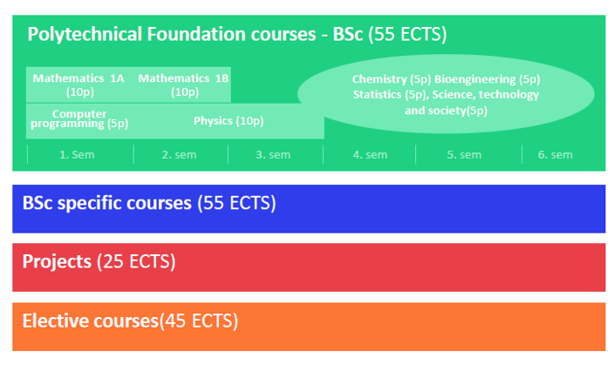
Polytechnical Foundation in the BSc programme

